Slide 1


Project InSense
“When Things started Thinking”

Slide 2


Agenda
Introduction to IOThinking
Prototype
Risk and Mitigation Strategies
Opportunities to Deloitte RFA
Future Scope
Copyright © 2019 Deloitte Development LLC. All rights reserved.36 USC 220506

Slide 3

Internet Of Thinking
A balance of cloud and edge compute to deliver intelligence everywhere
How do we do it?
Extending compute beyond the cloud, towards the edge of networks which helps us circumvent latency through hardware accelerators resulting in increased real-time intelligent actions.
Copyright © 2019 Deloitte Development LLC. All rights reserved.36 USC 220506

Slide 4
Ergonomic Assessment
Yes
No
Poly. (Yes)
Poly. (No)
Figure 1 - Results of Existence of Musculoskeletal Disorders
Nthubu B (2016) An Ergonomics Approach towards Efficient and Productive Maintenance of Fluidized Bed Heat Exchangers (FBHEs) (Morupule B Power Station).
J Ergonomics 6: 167. doi:10.4172/2165-7556.1000167
Copyright © 2019 Deloitte Development LLC. All rights reserved.36 USC 220506

Slide 5

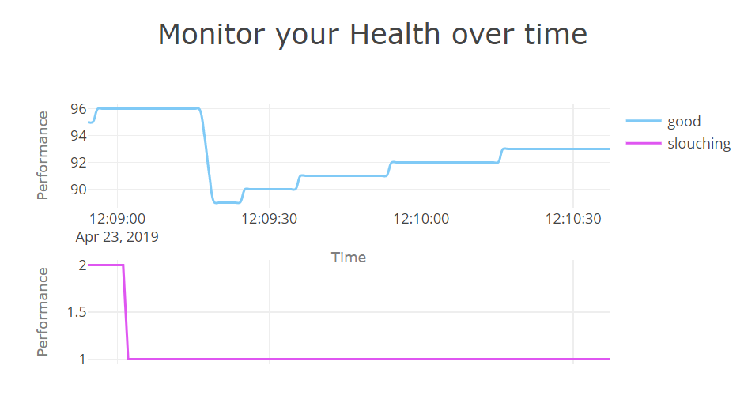


Project InSense
Scoreboard
Statistics
Feedback
Copyright © 2019 Deloitte Development LLC. All rights reserved.36 USC 220506

Slide 6
Is your ecosystem secure?
Costly and Complex Fixes
Security flaws detected can be costly to retroactively fix given the complex physical nature of assets. (Eg: Automobiles, Industrial infrastructure, etc.)
Safety Hazards
Device malfunction or Operational outage can cause health and safety hazards depending its intended use.
Widespread Device Manipulation
Vulnerabilities can amplify cyber attack surfaces from wide spread exploitation impact given the volume, diversity, and complexity of device networks and asset characteristics.
Noncompliance with privacy regulations
Laws such as GDPR, HIPAA and PCI-DSS require that companies have commensurate security tools in place. Noncompliance could result in severe fines.
Algorithmic Risk
Reputational, operational, financial, regulatory, strategical, technological.
Copyright © 2019 Deloitte Development LLC. All rights reserved.36 USC 220506

Slide 7
Opportunities for Deloitte RFA
The Deloitte “Secure, Vigilant, Resilient” framework would enable organizations to remain competitive in a challenging IoThinking environment.
Secure
Vigilant
Resilient
Take a measured, risk-prioritized approach to defend against known and emerging threats.
Develop situational awareness and threat intelligence to identify harmful behavior.
Have the ability to recover from and minimize the impact of cyber incidents.
Data Protection
Application
Security
Threat
Management
Data Protection
Threat
Management
Identity
Authentication, Access Management, Provisioning, Transmission Security, End Point Security, Storage Protection and Encryption
Threat Intelligence, Vulnerability Management, Logging and Monitoring, Change and Release Management
Crisis Management, Incident Response, Risk Reporting
Copyright © 2019 Deloitte Development LLC. All rights reserved.36 USC 220506

Slide 8










Scope of IoThinking in the near future
Aerospace Industry
Insurance
Banking
Life Sciences
Travel
If Internet of thinking were to be seen as an advancement of Turnkey IoT:
10-40% reduced reactive maintenance.
5-25% improved employee productivity.
2-6% increased asset availability.
5-25% reduced IT costs.
3-4% reduced environmental health and safety incidents.
With IoThinking, these proven growths of Turnkey IoT are only bound to increase manifold
Copyright © 2019 Deloitte Development LLC. All rights reserved.36 USC 220506

Slide 9


Copyright © 2019 Deloitte Development LLC. All rights reserved.36 USC 220506

